Slide 1
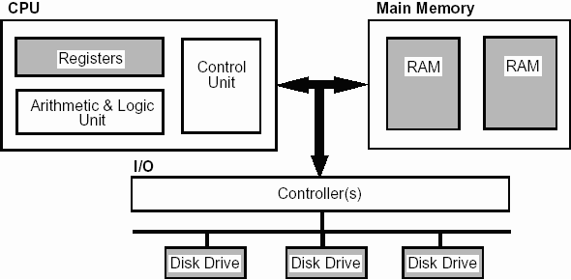

Slide 2
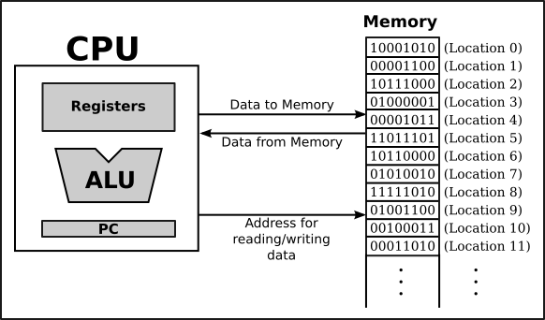

Slide 3
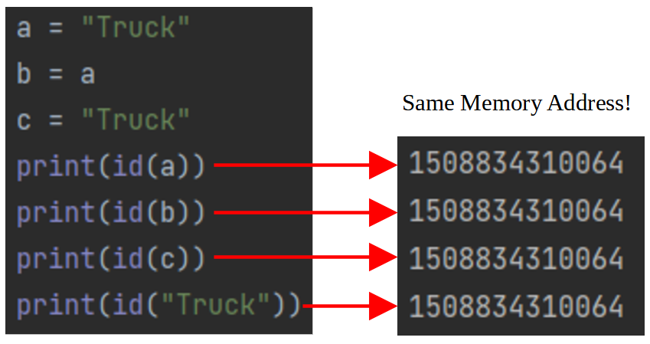

Slide 4
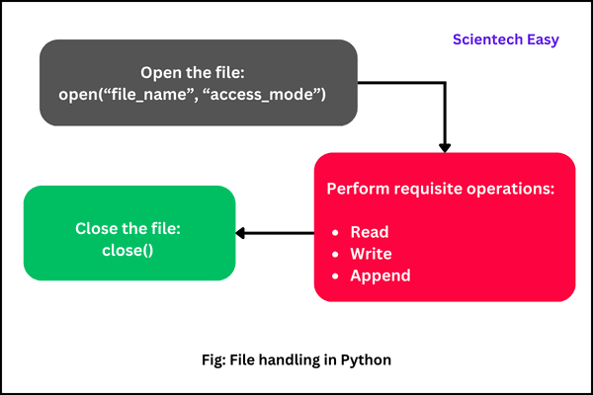

Slide 5
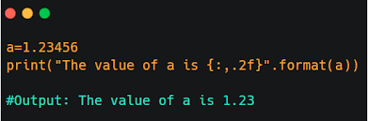

Slide 6
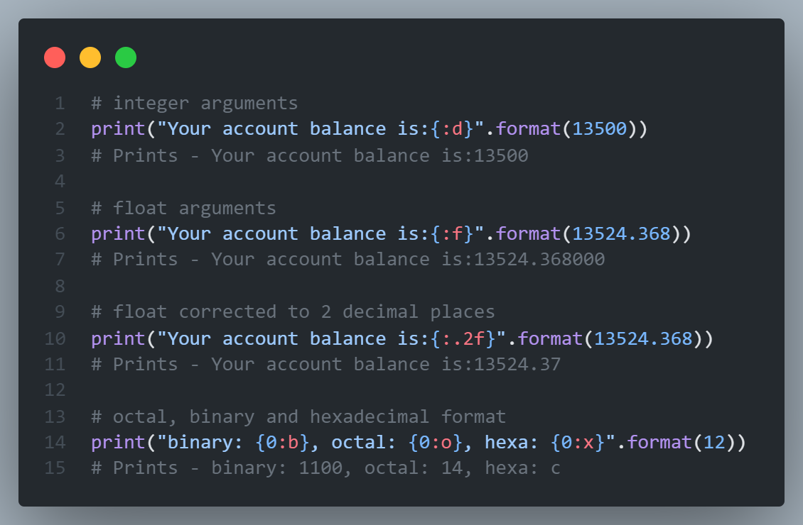

Slide 7
x = ['ab', 'cd']
for i in x:
i.upper()
print(x)
a) [‘ab’, ‘cd’]
b) [‘AB’, ‘CD’]
c) [None, None]
d) none of the mentioned

Slide 8
i = 1
while True:
if i%2 == 0:
break
print(i)
i += 2
a) 1
b) 1 2
c) 1 2 3 4 5 6 …
d) 1 3 5 7 9 11 …

Slide 9
i = 2
while True:
if i%3 == 0:
break
print(i)
i += 2
a) 2 4 6 8 10 …
b) 2 4
c) 2 3
d) error

Slide 10
Functions

Slide 11
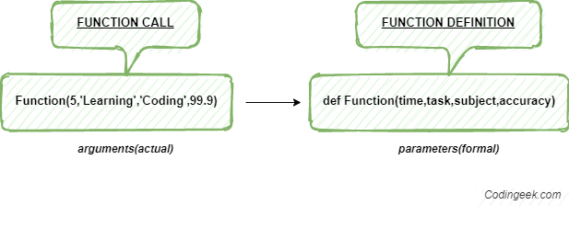

Slide 12
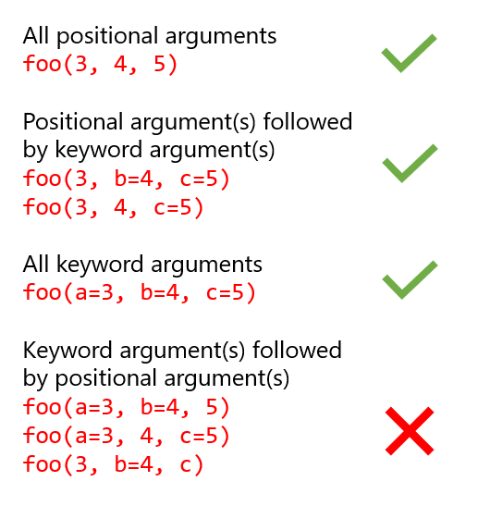

Slide 13
Scope of Variables

Slide 14
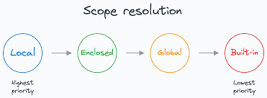

Slide 15
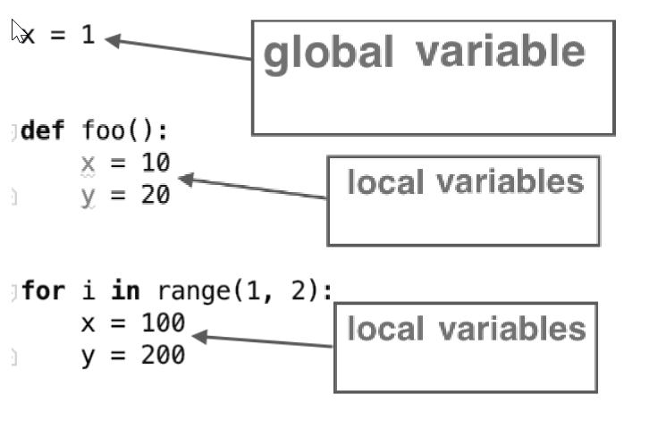
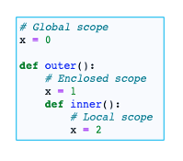

Slide 16
f=lambda x:bool(x%2)
print(f(20), f(21))
a) False True
b) False False
c) True True
d) True False

Slide 17
import functools
l=[1,2,3,4]
print(functools.reduce(lambda x,y:x*y,l))
a) Error
b) 10
c) 24
d) No output

Slide 18
x = 5
def modify():
global x
x = 10
modify()
print(x)
5
10
None
Error

Slide 19
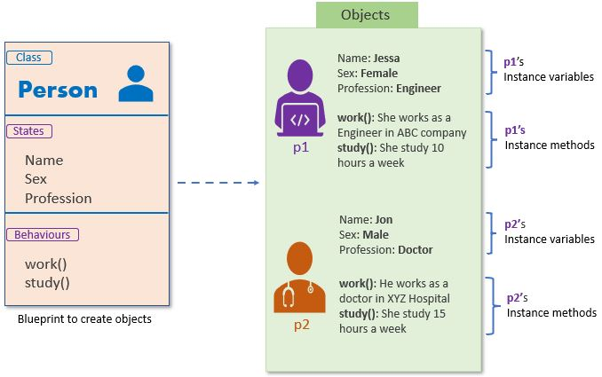
Classes and Objects

Slide 20
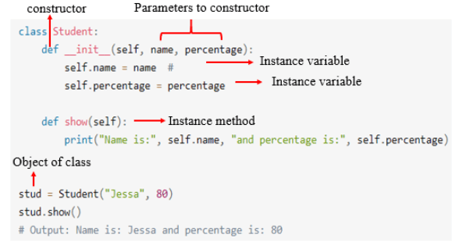

Slide 21
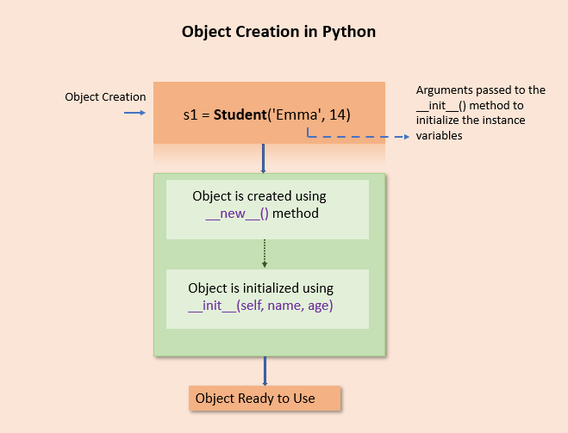

Slide 22
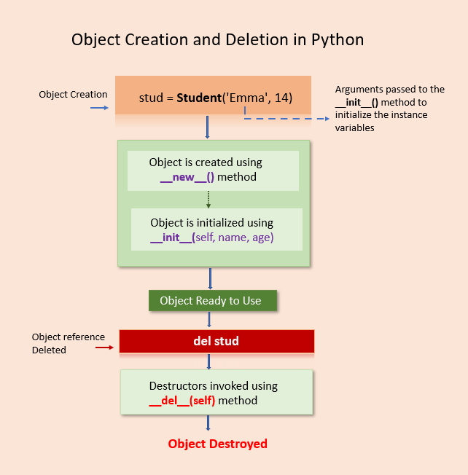

Slide 23
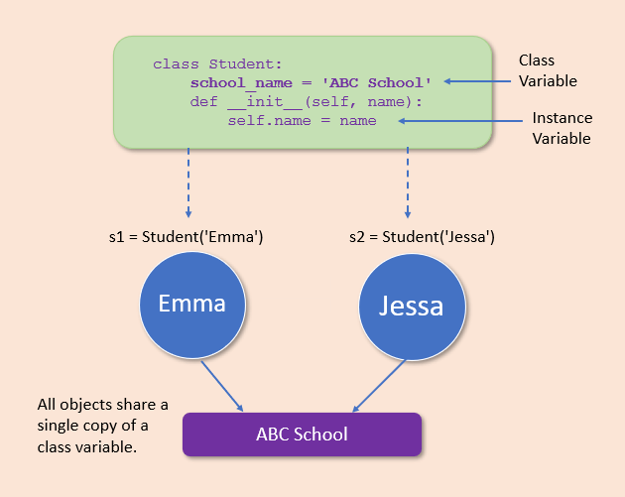
Class Variables

Slide 24
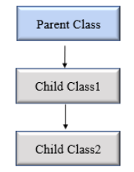
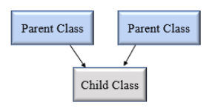
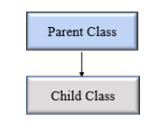
Python Inheritance
Single Inheritance
Multiple Inheritance
Multiple – Level
Inheritance

Slide 25
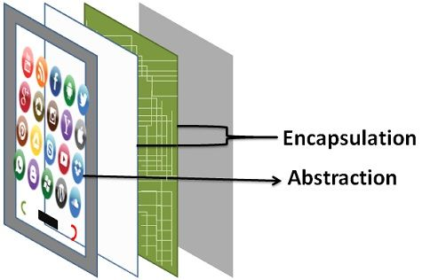
Python Abstraction

Slide 26
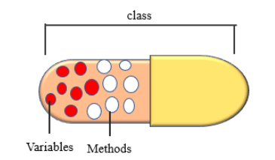
Python Encapsulation

Slide 27
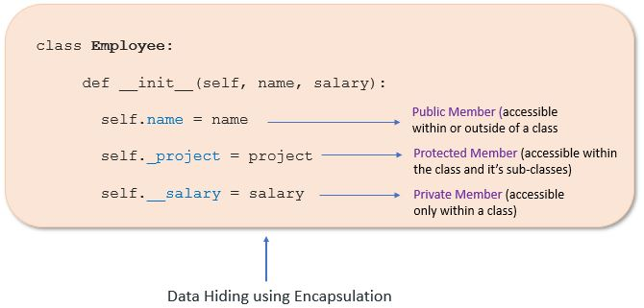
Access Modifiers

Slide 28
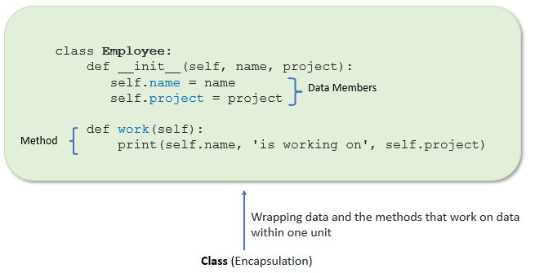

Slide 29

Python Polymorphism

Slide 30
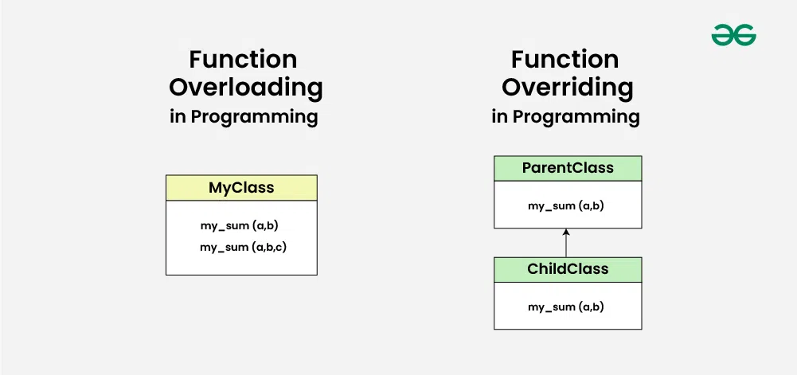

Slide 31
Decorators in Python
It is used to wrap a function
Adding new functionality without changing the original function.

Slide 32
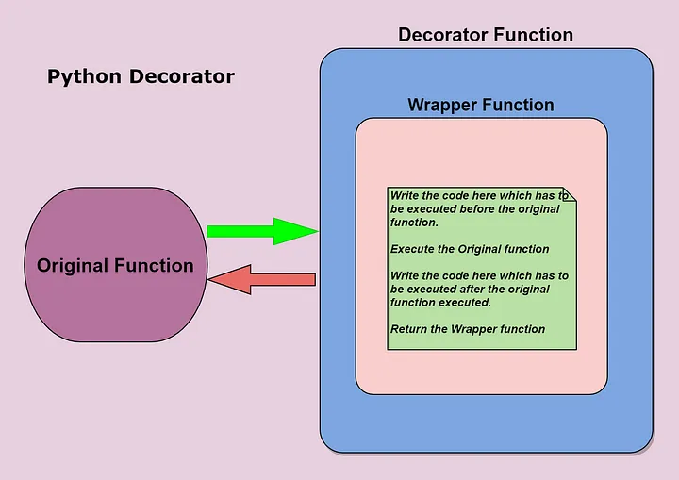

Slide 33
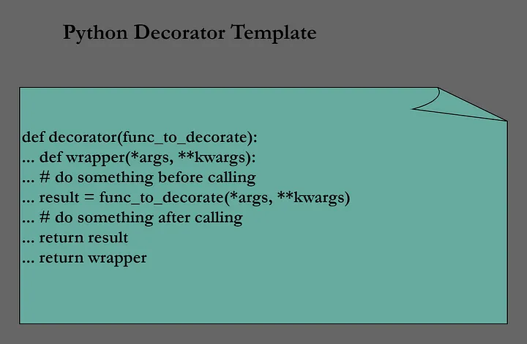

Slide 34
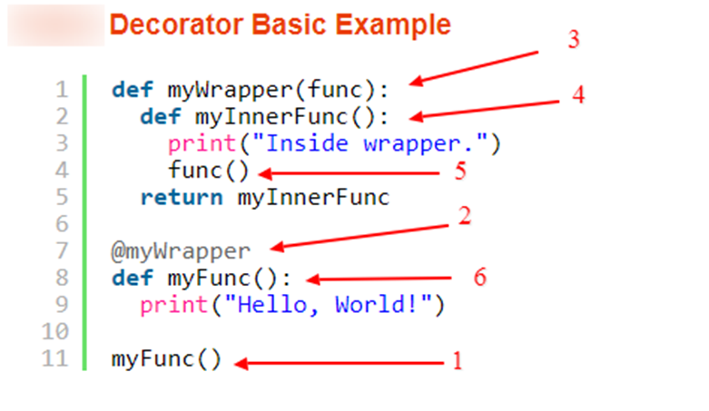
The original function is called (1).
There is a function wrapper name specified above the function definition (2). This indicates, that there is a function decorator assigned to the function.
The decorator function gets called. The program controller passes the function object as a parameter to the decorator function (3).
The function inside the decorator function gets executed (4).
The inner function calls the actual function (5).
The original function starts execution (6).

Slide 35
Multi-threading

Slide 36
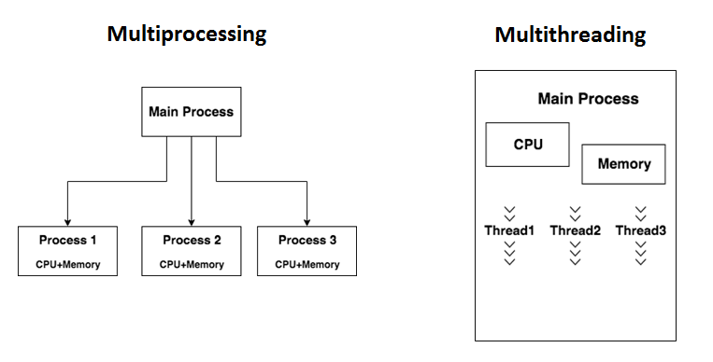

Slide 37
